Slide 1
Crime & Cannabis Legality
By Oliver Zagorin, Abdulmateen Oyediran, & Kayla Howard

Slide 2
Why Are we Looking
Multiple factors indicate that changing cannabis legal status has the potential to BOTH increase and decrease crime.
Alcohol and opioid use is thought to decrease when cannabis is available as an alternative.
There is less need for criminal cannabis organizations to use violence or carry weapons without fear of arrest.
Mass shooters have an anecdotal association with cannabis.
Major criminal organizations are thought to make the majority of their income off cannabis trafficking. Without this source they may explore more criminal alternatives.

Slide 3
Questions
How do crime rates differ between states?
How does cannabis legal status relate to different types of crime?
Do states with different legal statuses for cannabis have different crime rates?
How does cannabis legal status affect crime rates?

Slide 4
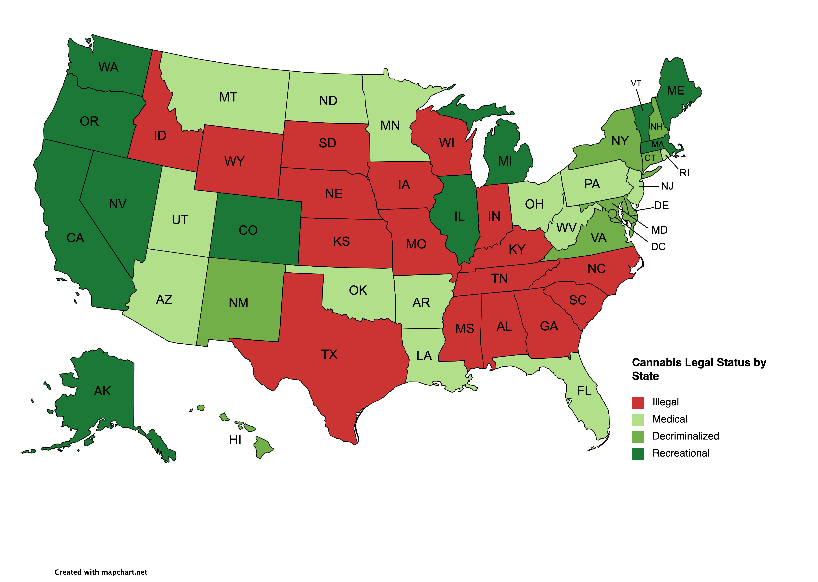
Cannabis Legal Status

Slide 5

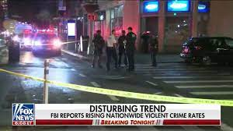
Data Sources

Slide 6
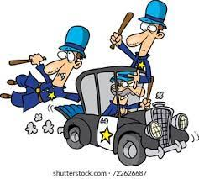
Why data is incomplete

Slide 7
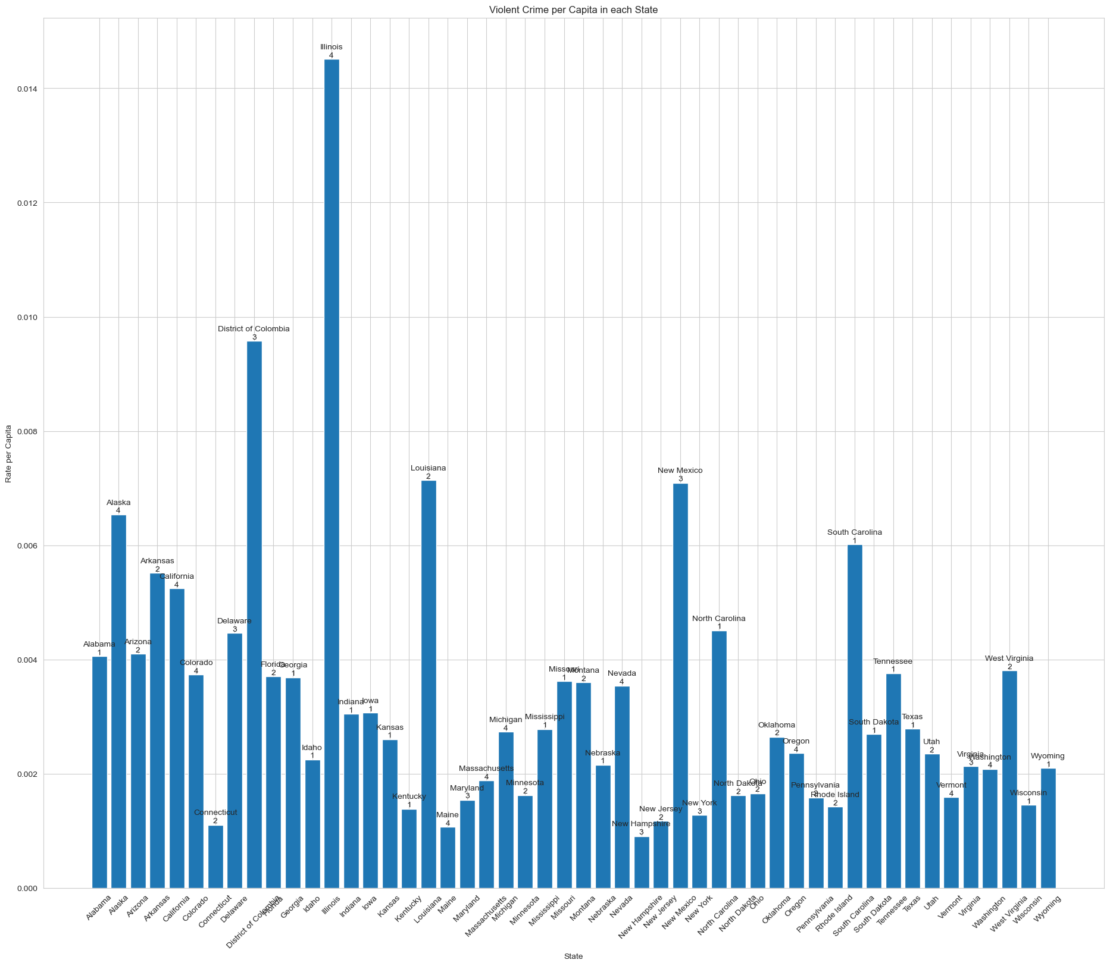
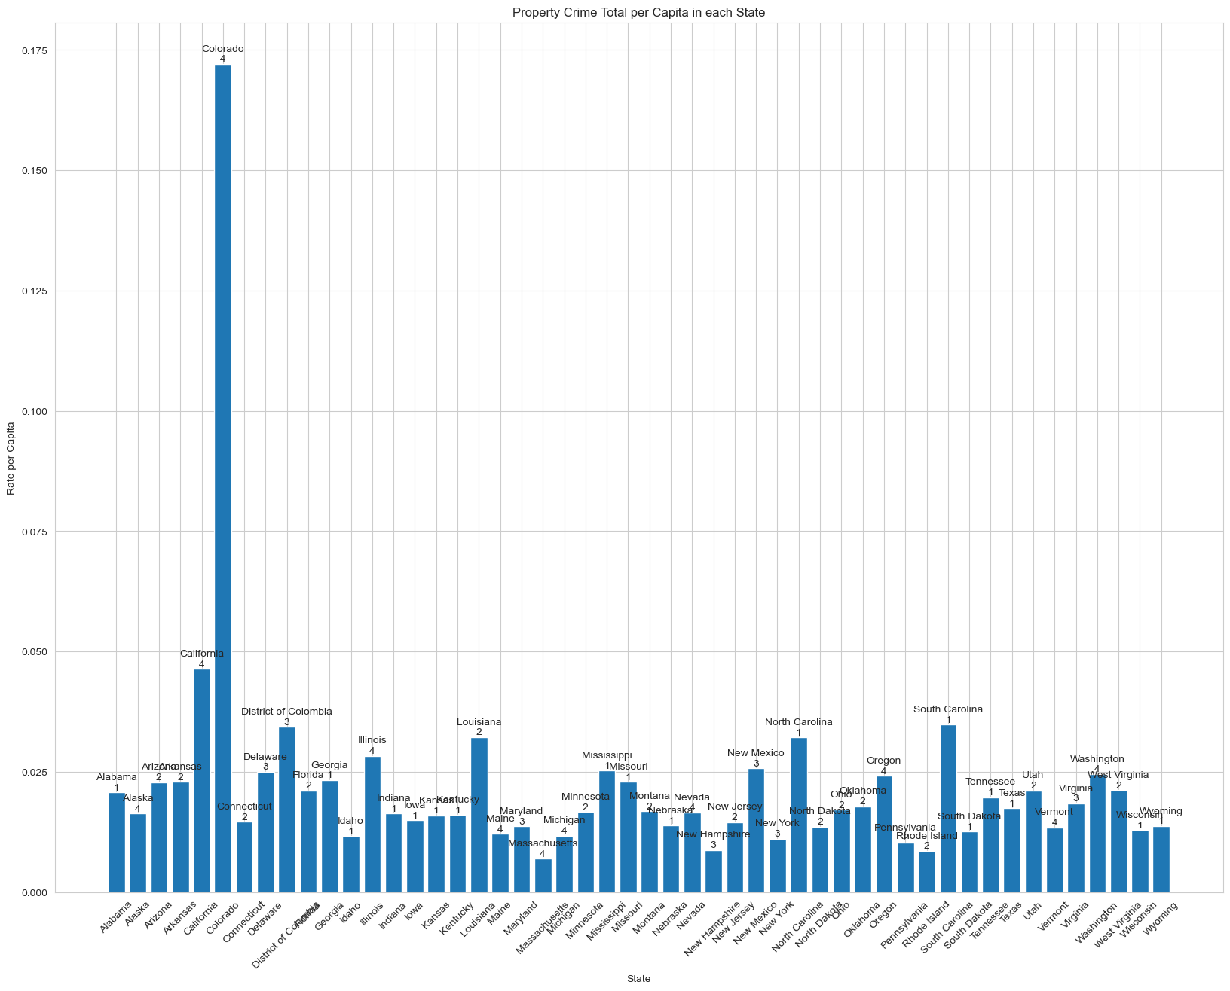
Type of crime by state
Violent Crime by State Property Crime by State

Slide 8
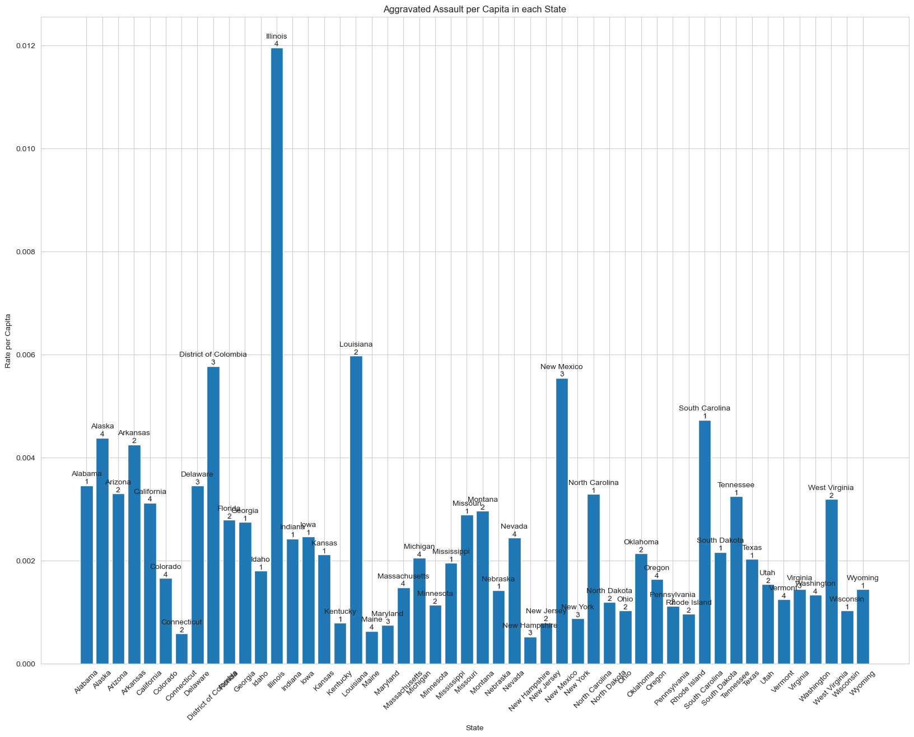
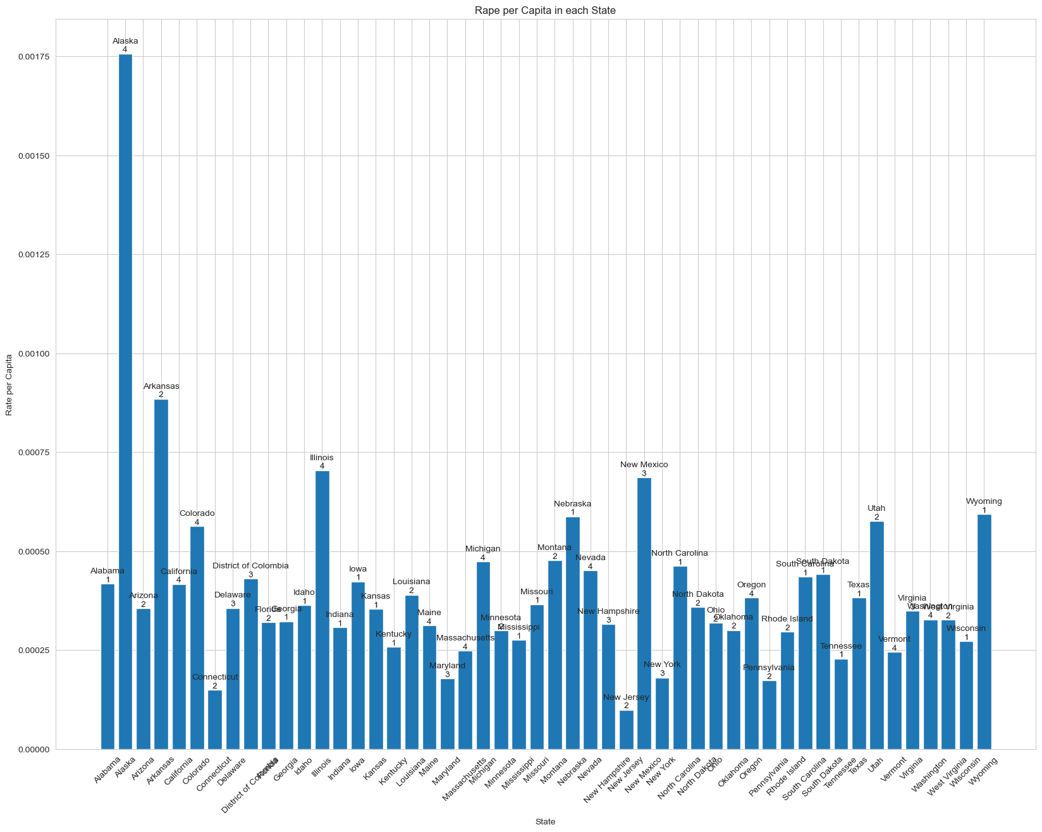
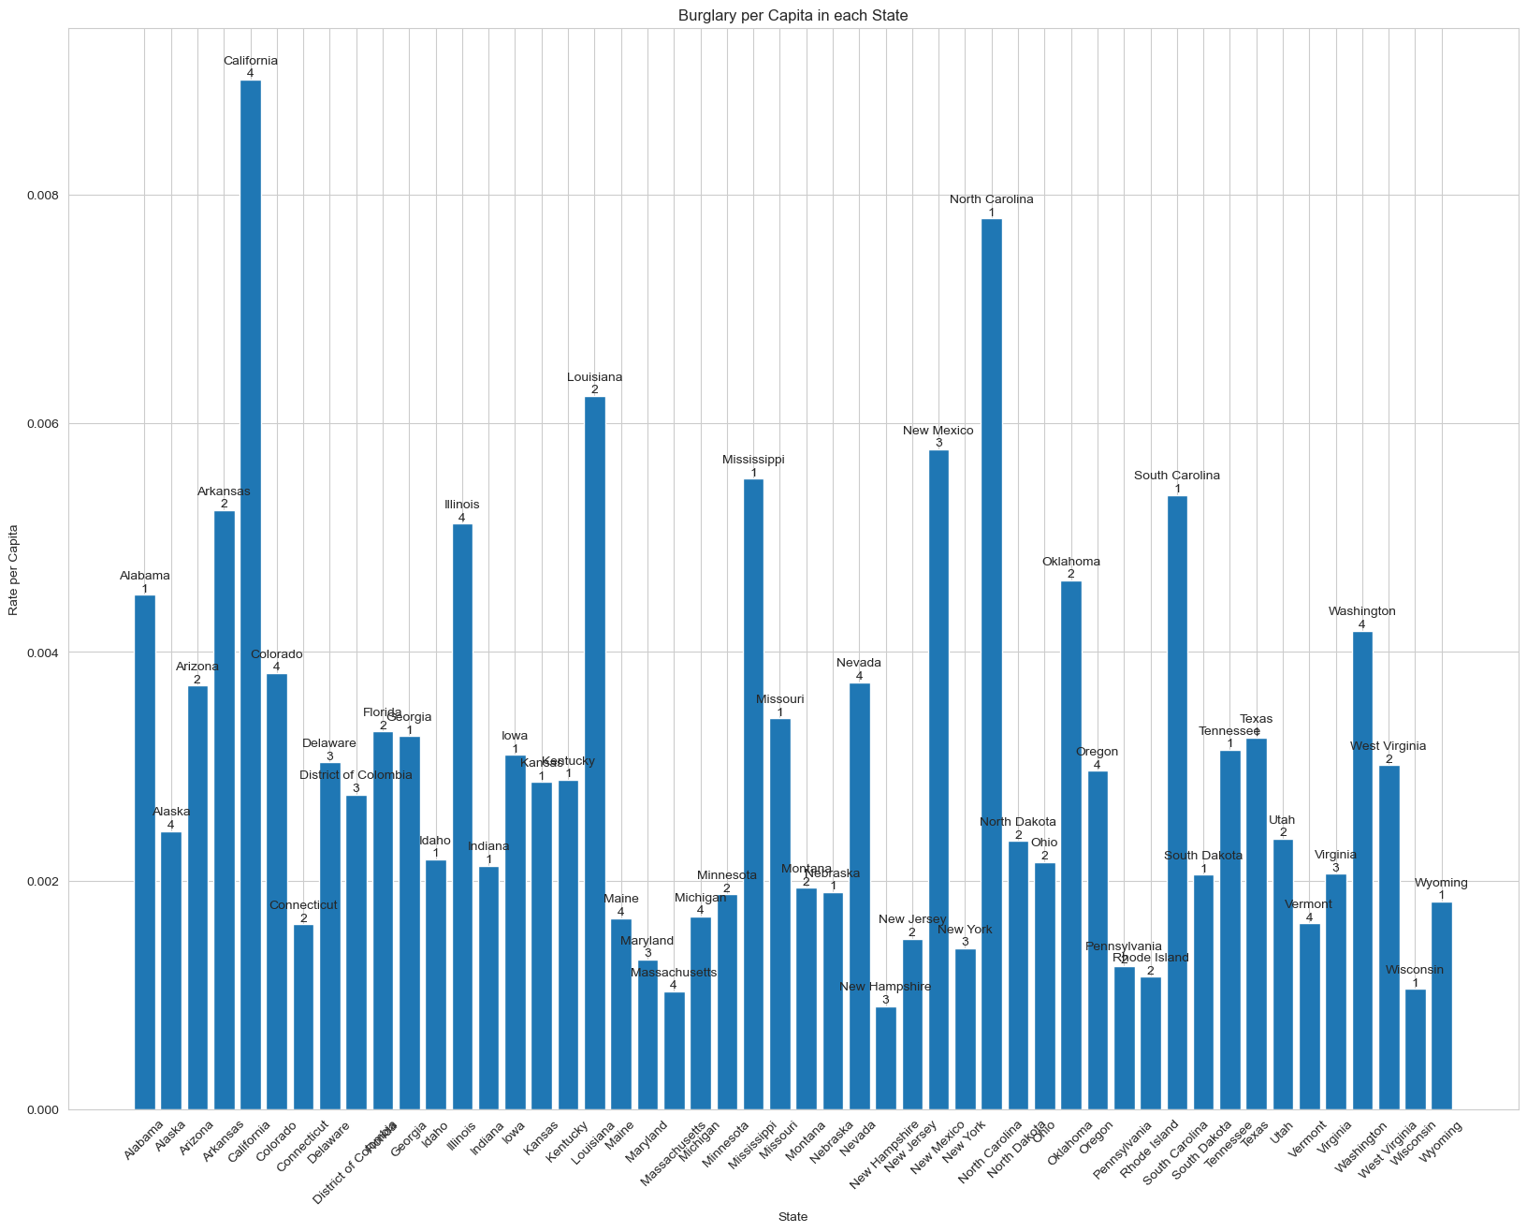
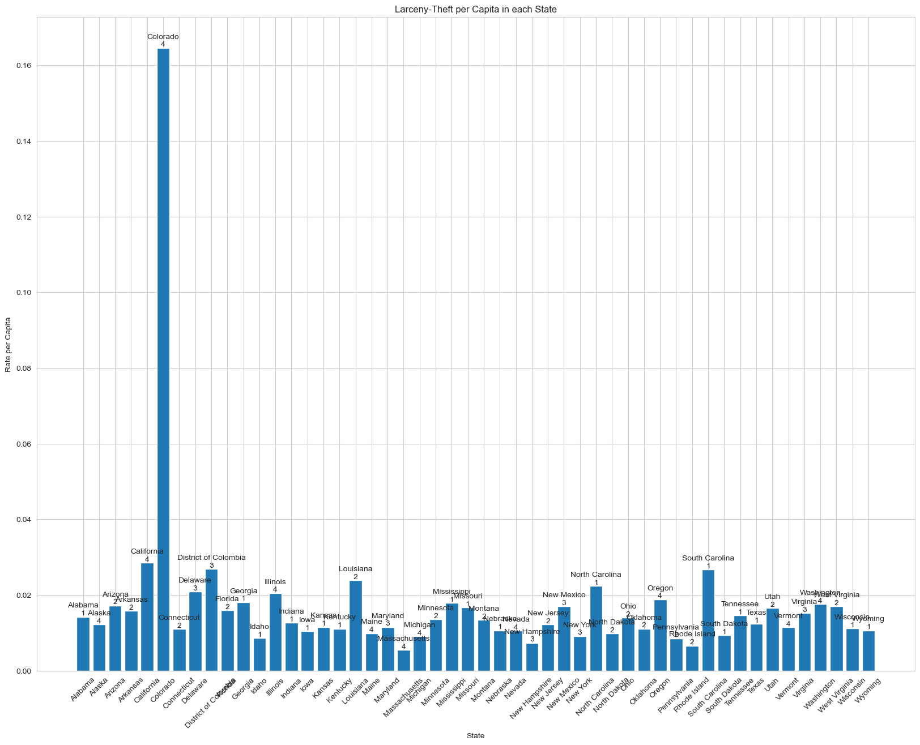
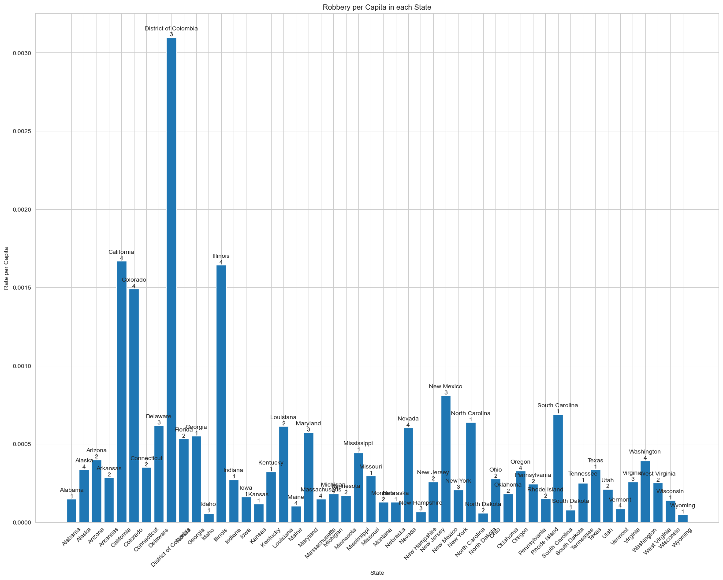
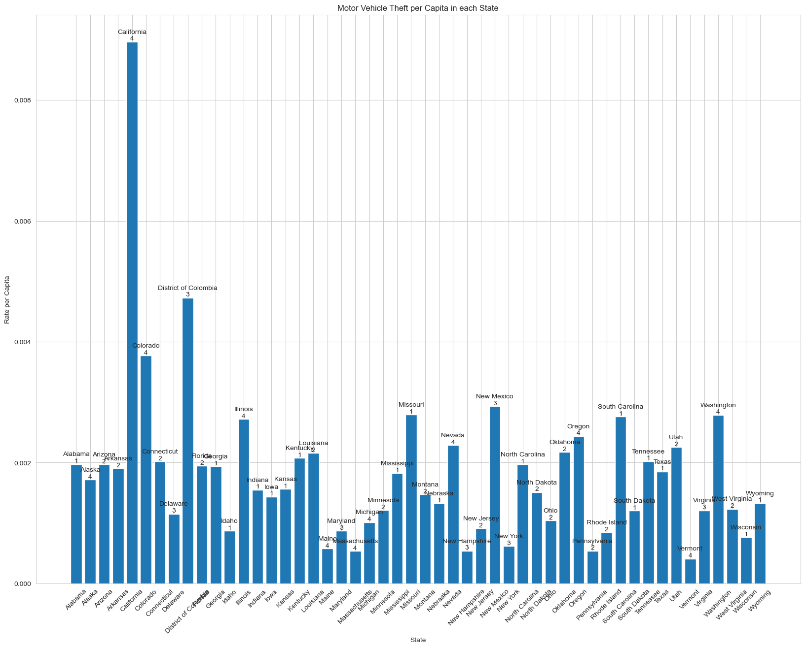
Violent Crime by State Property Crime by State

Slide 9
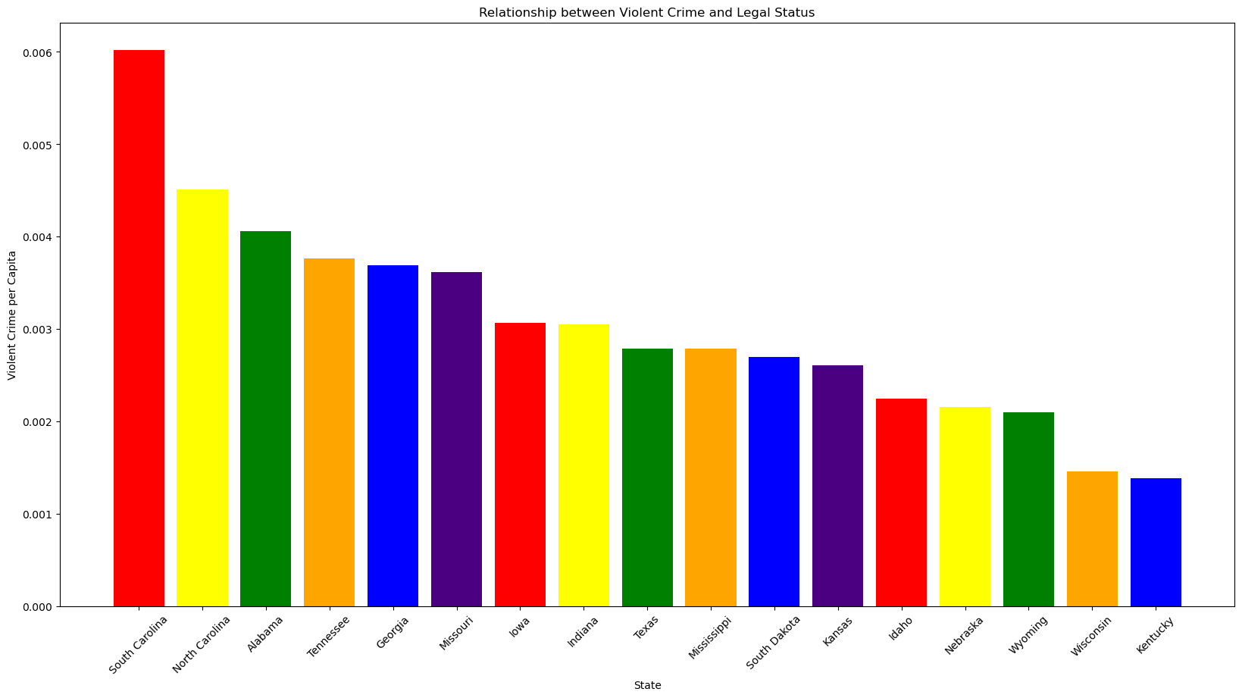
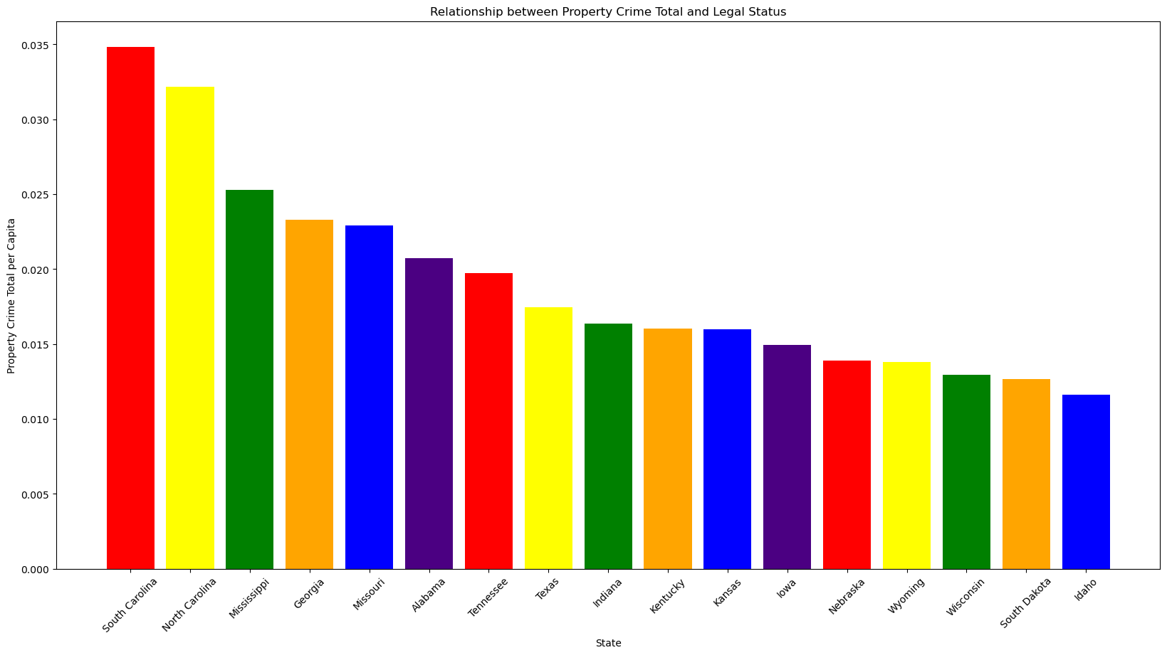
Crime where Cannabis is Illegal
Violent Crime
Property Crime

Slide 10
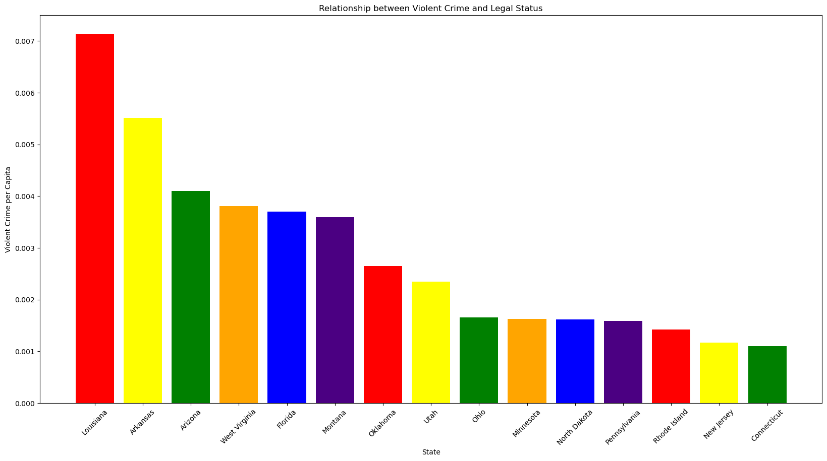
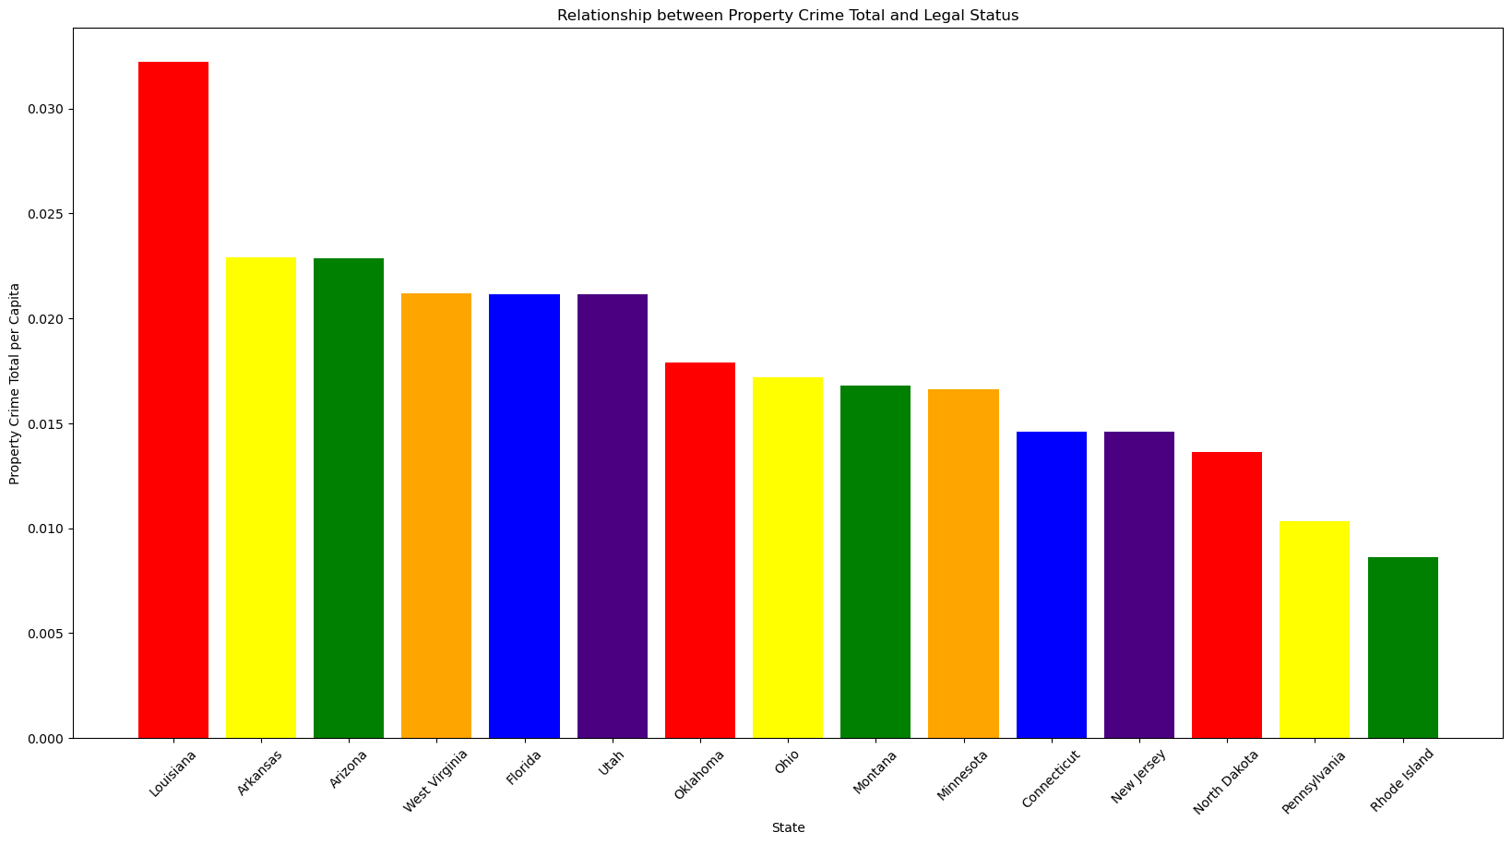
Crime where Cannabis is Medicinal
Violent Crime
Property Crime

Slide 11
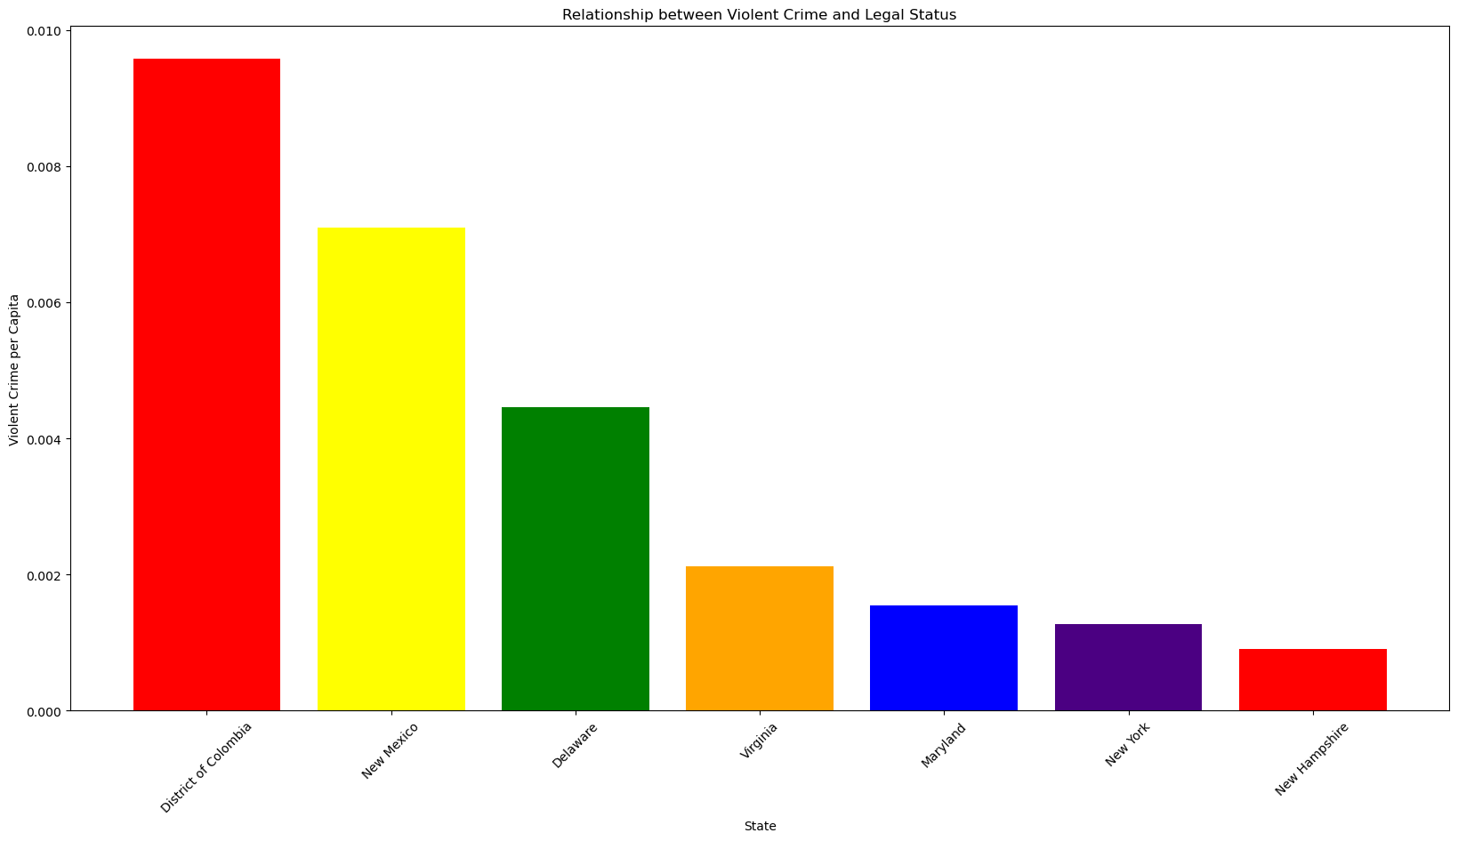
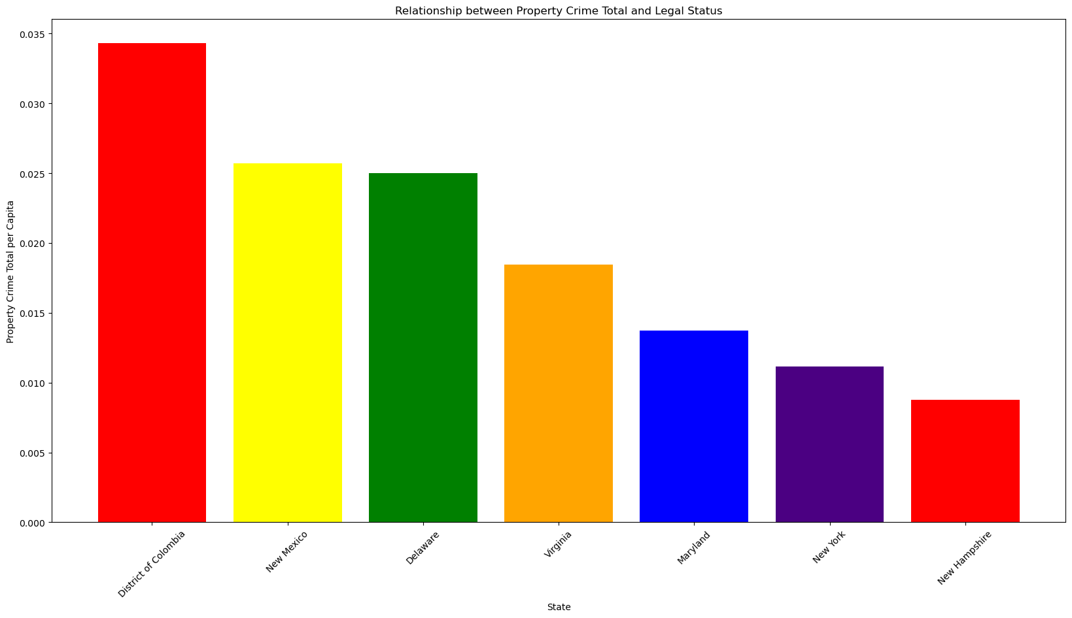
Crime where Cannabis is Decriminalized
Violent Crime
Property Crime

Slide 12
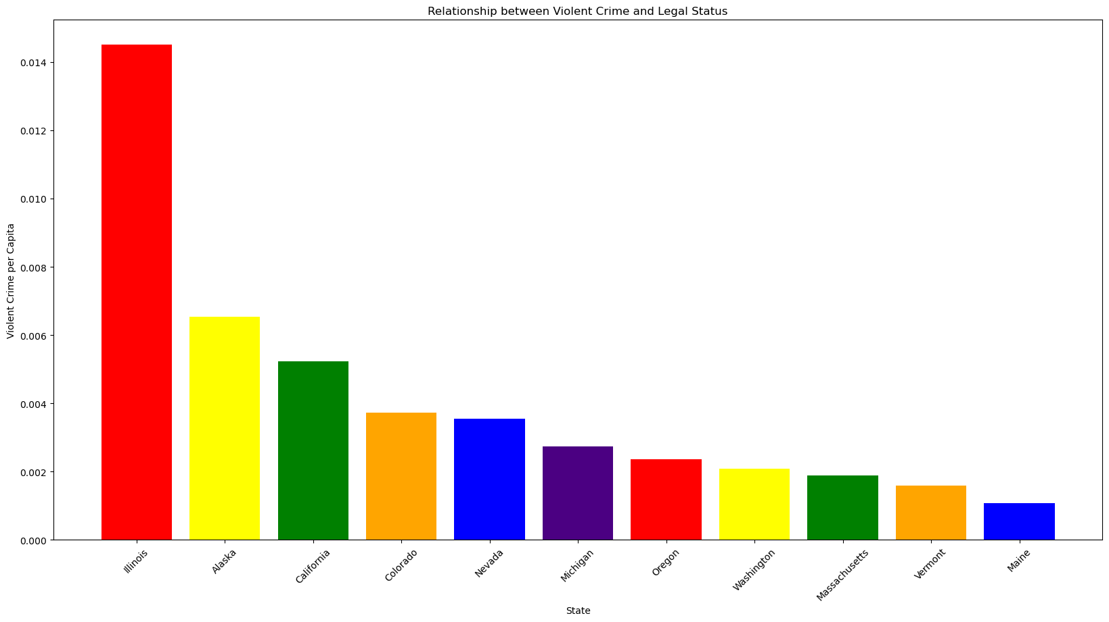
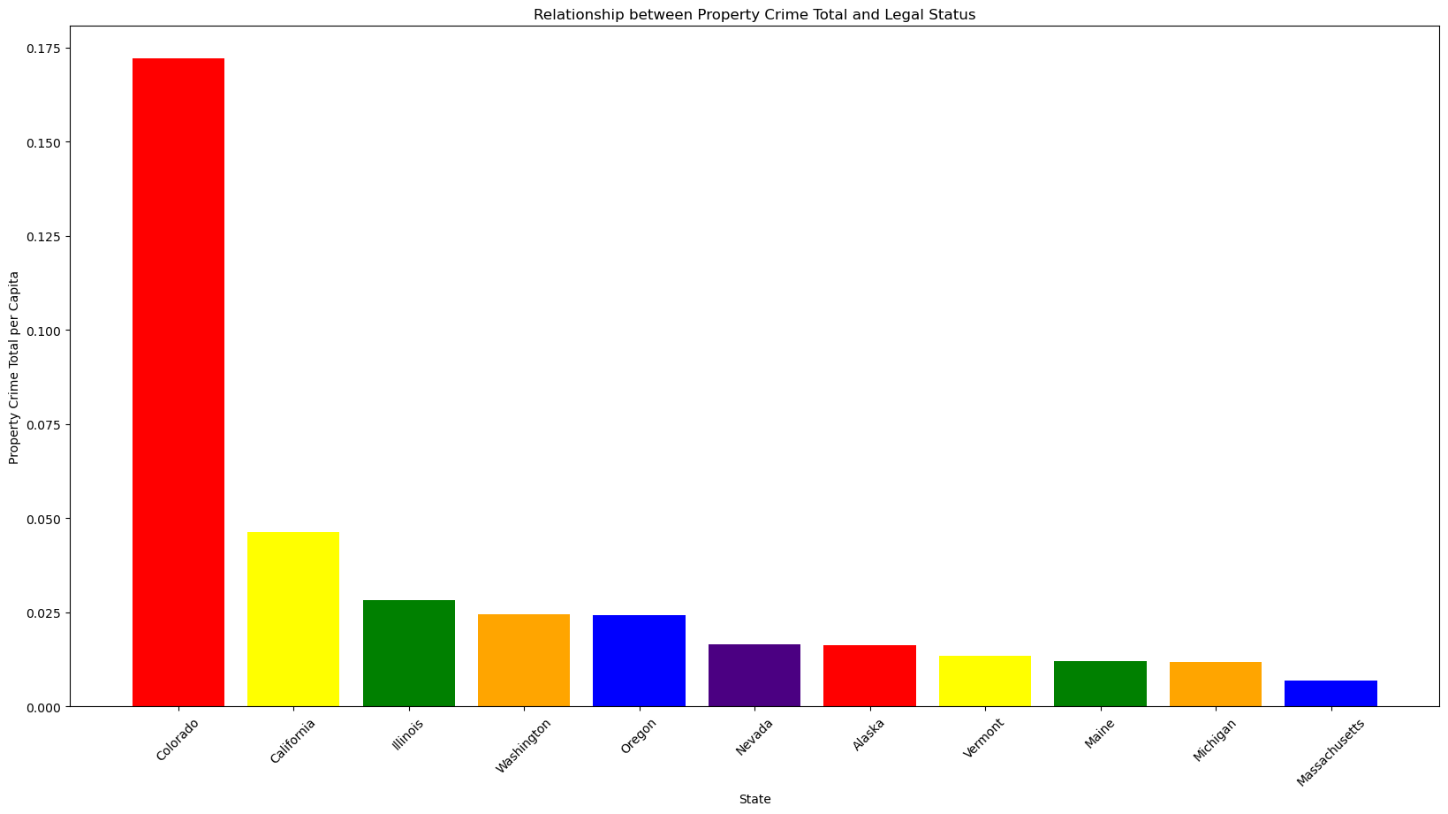
Crime where Cannabis is Recreational
Violent Crime
Property Crime

Slide 13

ANOVA showed that Cannabis Legal Status groups were frequently statistically significantly different from each other.

Slide 14
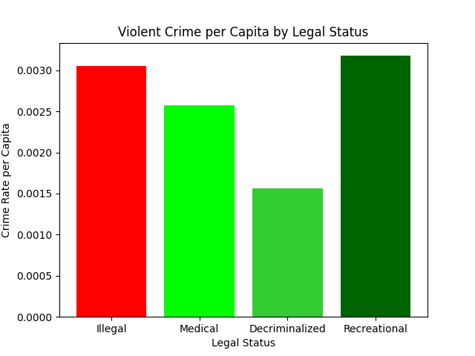
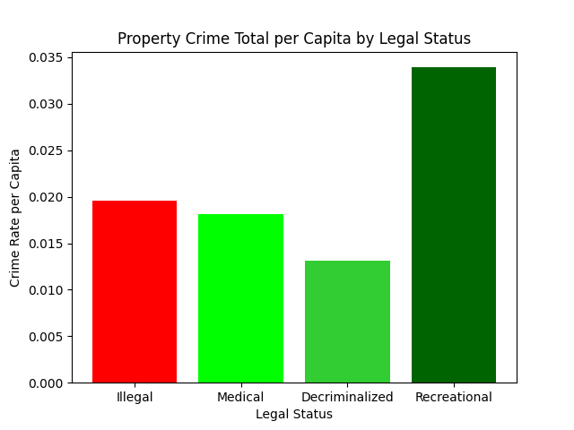
Mean graphs from ANOVA analysis

Slide 15
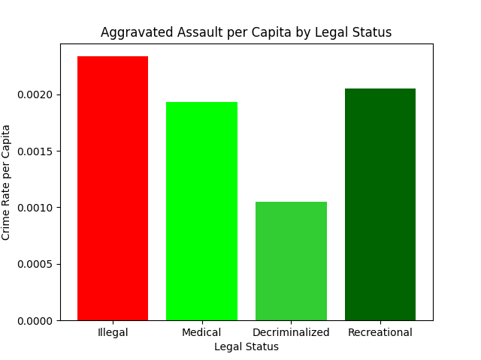
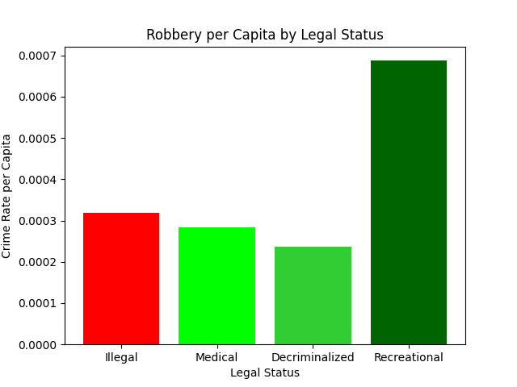
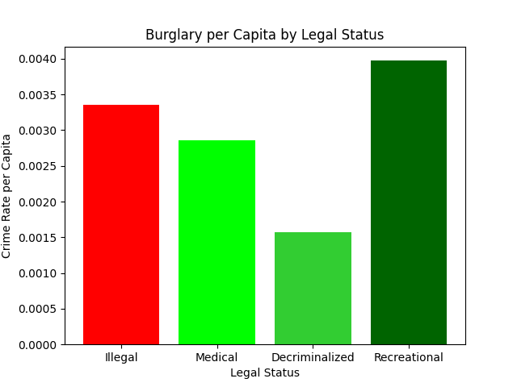
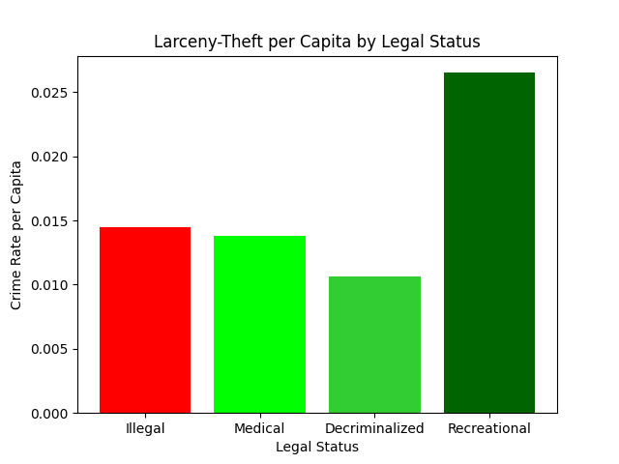
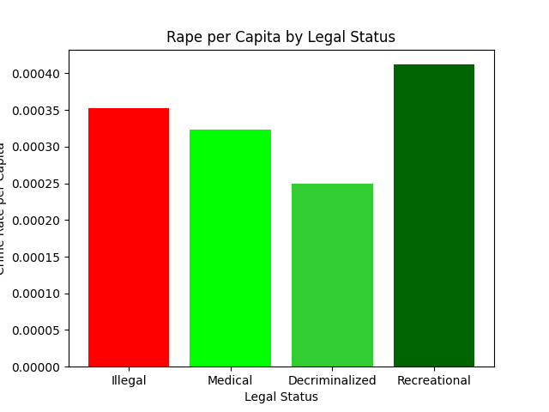
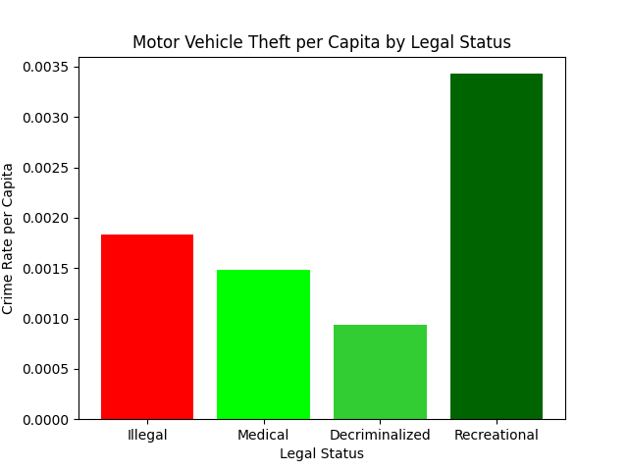
Violent Crime
Property Crime

Slide 16

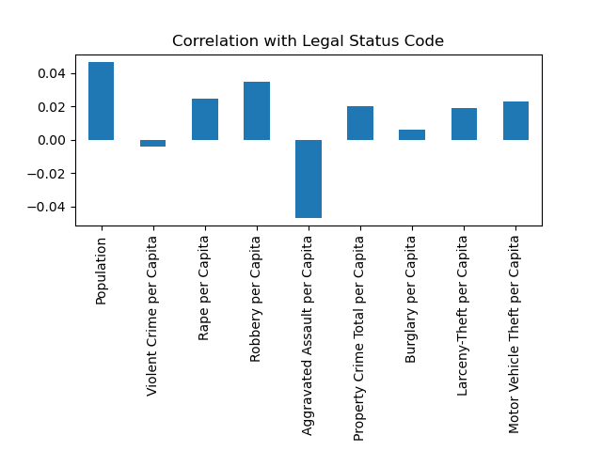

Correlation Analysis

Slide 17
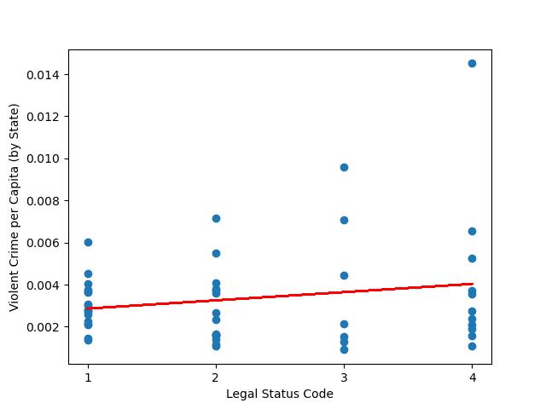
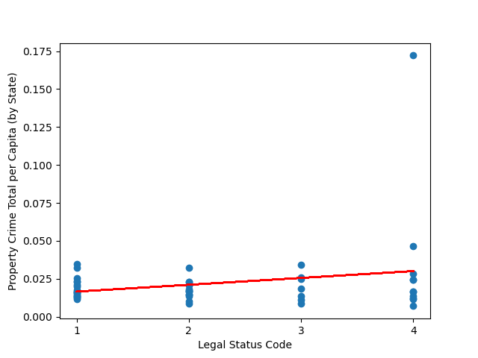
Regression Analysis
Violent Crime
Property Crime

Slide 18
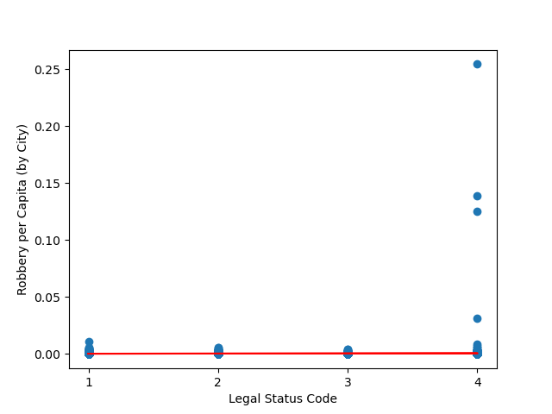
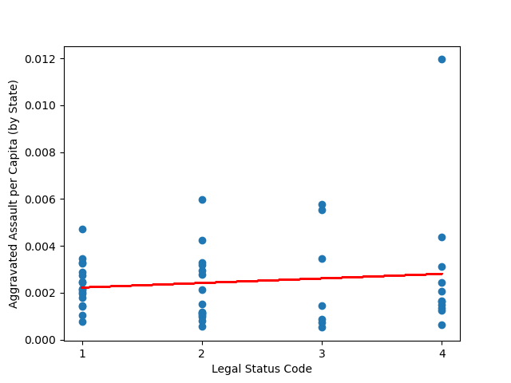
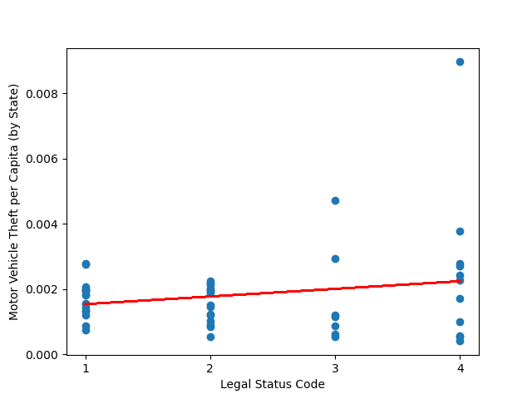
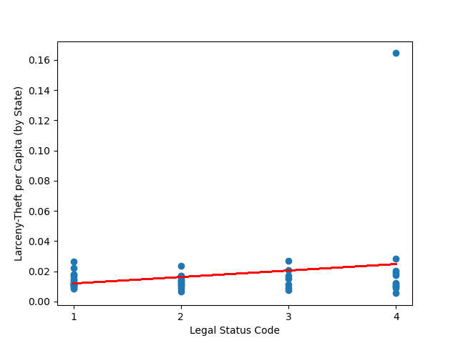
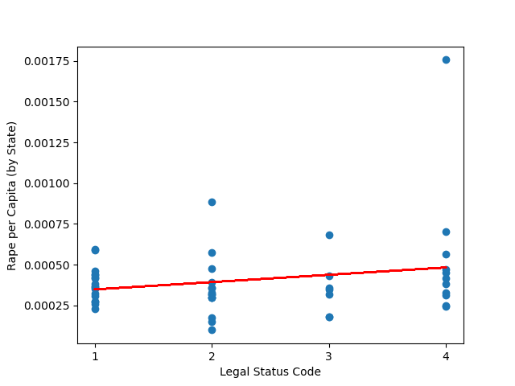
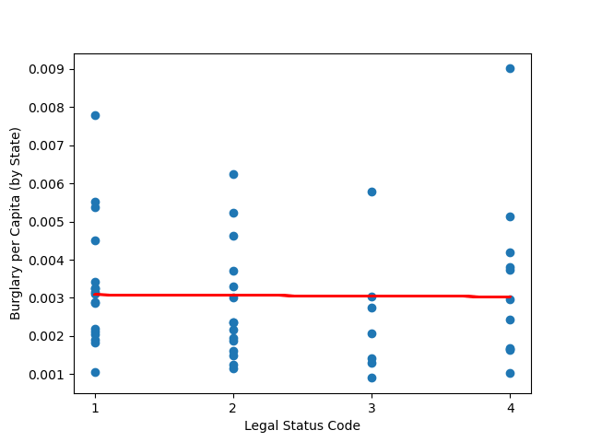
Regression Analysis
Violent Crime
Property Crime

Slide 19

Insights from Data
More lenient treatment of cannabis shows a decrease in crimes of all types measured
Until it comes to recreational cannabis which shows a dramatic increase in ALL crimes

Slide 20
Possible Explanations
Cannabis has been shown to decrease dependence on alcohol and opioids.
Decreasing penalties for possession makes it easier for medical patients, recreational users, and criminal organizations.
Recreational Marijuana sets up a competitive industry that competes DIRECTLY with the black and grey market cannabis industry.
Some of those working in the black and grey market are put out of business and need fresh streams of income, which may be more likely to be illicit.
Recreational Cannabis facilities can not use banks, setting them up to be prime targets for theft and violence.

Slide 21
Future Directions for Research
Improve reporting from Law Enforcement Agencies and repeat analysis.
Repeat this analysis over multiple years and as more states adopt more lenient stances towards cannabis.
Perform a comparative analysis of law enforcement agencies in recreational states in order to discover the lowest-crime implementation strategy.
Investigate the size and practices of black and grey markets in all states.
Investigate how black and grey markets respond to changes in cannabis’s legal status.
Investigate the role of cartels, and interstate criminal networks in different states and whether this differs significantly in recreational states.

Slide 22
Sources
United States Department of Justice, Federal Bureau of Investigation. Crime in the United States Annual Reports, Offenses Known to Law Enforcement, 2020. Retrieved February 2023, from https://cde.ucr.cjis.gov/LATEST/webapp/#/pages/downloads
https://www.themarshallproject.org/2022/06/14/what-did-fbi-data-say-about-crime-in-2021-it-s-too-unreliable-to-tell

